Slide 1

4.2 Risk, Trustworthy Repositories, & Audit
Trusted Repositories
Helen R. Tibbo
tibbo@email.unc.edu
September 12, 2016

Slide 2
Risk Management

Slide 3
Risk
What is risk?

Slide 4
Business Risk
What is business risk?

Slide 5
Defining Risk
“Risk refers to the uncertainty that surrounds future events and outcomes. It is the expression of the likelihood and impact of an event with the potential to influence the achievement of an organization’s objectives.”
DCC & DPE. (2007). DRAMBORA. 1.0 , pp. 221 (p. 33).
http://www.repositoryaudit.eu/

Slide 6
Risk Assessment & Management
Why do projects, repositories, and organizations need to do risk assessments and manage risk?
Digital repositories and all their parts are complicated, expensive, and risky.
You need to plan for risks and assess how much risk your institution is willing to take on.

Slide 7
Exercise 1: Risk Assessment
Working in small groups, list as many risks as you can regarding your unit’s data and any digital repositories.
For this exercise, these risks should focus on the continuity/authenticity of the data (e.g., data corruption).

Slide 8
Types of Risks for Repositories
Assets or activities fail to achieve or adequately contribute to relevant goals or objectives
Threats to organisational assets: information (databases, data files, contracts, agreements, documentation, policies and procedures), software assets, physical assets, services and utilities, processes, people, intangibles such as reputation and cultural value
Further, internal threats and external threats pose obstacles to success of one or more activities
Ross, S. (2009). DRAMBORA in action. Interactive Demonstration, DigCCurr Professional Institute, Chapel Hill, NC, June 14-19, 2009.

Slide 9
Business Risk in Libraries/Archives
The risk-assessment model we’ll talk about today has its origins at LC.
LC has an extensive internal audit system.
Developed with financial auditors from KPMG LLP.
First model to “account” for the well-being of heritage assets.

Slide 10
Determining Risk
Risk must be defined in terms of institutional or project mission.
For LC:
“to acquire, preserve, and make maximally accessible the intellectual and information heritage of the United States and, to the degree desirable, the world.” (1997)
Emphasizes collections care and long-term preservation.

Slide 11
LC’s Business Risks
The risk of not acquiring materials that are critical to the continued development of the research collections that meet the needs of Congress and the research community.
The risk of failing to make the collections available to users in a timely and appropriate fashion.

Slide 12
LC’s Business Risks
The risk of not preserving the collections from the physical degradation inherent in each of the various media the Library holds, and from deterioration through use; and
The risk of exposing the items in the collection to theft, mutilation, or accidental loss.

Slide 13
What Are Your Business Risks If Your Data Systems Fail?

Slide 14
So, How Can You Deal with Risk?
What approaches would you take to anticipate and manage risk???

Slide 15
Simplified Risk Mitigation Model
Risk Identification
Risk Analysis
Response to Risk
Control Assessment

Slide 16
Establishing LC’s Risk
The risk is assessed as high, medium, or low, depending upon the degree to which present policies and procedures make it possible to acquire, serve, preserve, and safeguard materials.
What elements determine the above?
Value of materials
Format of materials
Likelihood of risk occurring
What elements determine risk associated with your data?

Slide 17
Establish Relevant Controls
For LC:
Bibliographic
Preservation
Inventory
Physical Security

Slide 18
Conducting Risk Assessment
Define risks.
Conduct interview and walk-though.
Document the control environment.
Define the key controls.
Define the control weaknesses.
Assess degree of risk.
Separate acceptable/unacceptable risks.
Report results.
Incorporate actions into plans.
Implement actions and plans.

Slide 19
Managing Risk - ATAR
Compare costs of potential risks to costs of potential losses.
You can relate to risk in 4 ways:
Accept.
Transfer.
Avoid.
Reduce.

Slide 20
Exercise 2: Risk Management
Working in groups, identify potential risks to data and discuss what is the most appropriate management approach for each risk.

Slide 21
Reducing Risk
Strategic Controls.
Management Controls.
Process Controls.

Slide 22
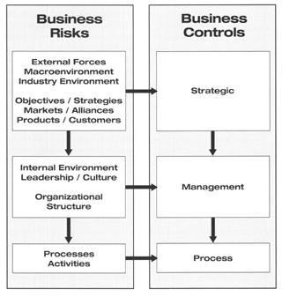
Interrelationships between Business Objectives, Strategies, Processes, & Risks

Slide 23
Risk Mitigation Flow Diagram
Define process control objectives
Assess business risk at the process level
Design and implement effective controls
Measure process performance
Monitor process control activities

Slide 24
DRAMBORA Digital Repository Audit Method Based on Risk Assessment
Initiative of the Digital Curation Centre (DCC) & DigitalPreservationEurope (DPE)
DRAMBORA released (March 2007)
DRAMBORA Interactive debuted (March 2008)
Methodology for conducting repository self-assessments
Tool to facilitate assessment and document results
Reporting tools on the outcomes of the assessment
List risks, assign roles to staff, and assess likelihood and severity.

Slide 25
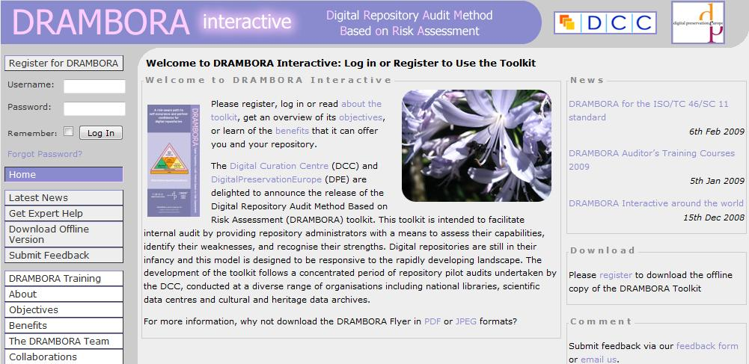
http://repositoryaudit.eu

Slide 26
DRAMBORA Assessment Principles
It should be a self-audit that repositories do themselves, based on the provided tools
Self-audit may be a preparatory step for taking an external audit
It should be flexible & valid for repositories of all shapes and sizes and of different contexts (i.e., disciplinary, organizational, institutional)
It is for assessing how well the repository is managing the risks it is facing when it does what it does
It should result in advice for overcoming risk situations and inform you on what other repositories have done in similar situations.
Ross, S. (2009). DRAMBORA in action. Interactive Demonstration, DigCCurr Professional Institute, Chapel Hill, NC, June 14-19, 2009.
Notes:
26
23.03.2009
Session 1: Digital Repository Assessment Landscape

Slide 27
What are Trustworthy Records/Data/ Digital Objects?

Slide 28
Authentic
First, trustworthy records, data, or any digital object must be authentic. That is, it must be what it purports to be and is free from tampering or corruption.
Interpares Project 2 Dictionary (http://www.interpares.org/ip2/display_file.cfm?doc=ip2_dictionary.pdf&CFID=9050554&CFTOKEN=31567709)

Slide 29
Complete
“Creating records which contain all relevant content and contextual information not only ensures that the transaction in question has been fully and appropriately documented, but also that the record has value as a source of information to others.” –JISC InfoNet http://www.jiscinfonet.ac.uk/infokits/records-management/creation/complete-records

Slide 30
Reliable
“Reliability is the third key quality common to all records worthy of the name… A record may have been created by the appropriate, authorised person and it may contain all of the elements that it should but these will count for little if that content is itself factually incorrect.”
–JISC InfoNet http://www.jiscinfonet.ac.uk/infokits/records-management/creation/reliable-records
“The trustworthiness of a record as a statement of fact. It exists when a record can stand for the fact it is about, and is
established by examining the completeness of the record's form and the amount of control exercised on the process of its
creation.”
- Interpares Project 2 Dictionary

Slide 31
Now What?
We have trustworthy (authentic, complete, reliable) records (or data, or other digital objects) and we want to keep them that way for infinity and beyond… or the life of the republic plus 40 years… or at least until we are retired!
How do we go from great records/data/digital objects to a great repository?
How do we know if we have a trustworthy repository?
How do our customers (internal as well as external) know if we are likely to keep their materials safe for the foreseeable future or as long as they want them kept?

Slide 32
Trustworthy Repositories in the Old Days
Analog repositories
Trustworthiness based on reputation and years of archiving.
Track record with maintaining materials.
Often reluctance to advertise/announce/admit loss.
No accrediting body, process, or standard.
Ambient good practice with some basic manuals.
Donors/content creators/institutions had very little with which to assess repositories.
Why did this seem OK?

Slide 33
Why Is This No Longer Sufficient???

Slide 34
Establishing Trustworthy Digital Repositories
These efforts date to 1996
No track records with digital materials beyond institutions such as NARA
Initially no best practice (well, there’s always a “best” practice, but good practice was unclear)
Call for description, documentation, and auditing of digital best practices for long-term repositories.
Garrett, John & Donald Waters. “Preserving Digital Information: Report of the Task Force on Archiving of Digital Information.” The Commission on Preservation and Access and RLG, 1996. http://www.rlg.org/legacy/ftpd/pub/archtf/final-report.pdf.

Slide 35
Highlights in History of Trustworthy Digital Repository Audit and Certification Activities
TDR, 2002
OAIS, 2002
TRAC, 2005-2007
CRL 10 points, 2007
DRAMBORA, 2008
Data Seal of Approval, 2008
NESTOR, 2003
ISO 16363:2012
European Framework for Audit & Certification, 2012
DSA, ISO 16363 self audit, & ISO 16363 formal audit

Slide 36
“Trusted Digital Repositories”
RLG, “Trusted Digital Repositories: Attributes and Responsibilities.” An RLG-OCLC Report. Mountain View, CA: Research Libraries Group, 2002. http://www.oclc.org/resources/research/activities/trustedrep/repositories.pdf
Definition of a TDR
Attributes of a TDR
Responsibilities of a TDR
Certification of a TDR
Appendix on OAIS

Slide 37
Attributes of a TDR - 2002
Compliance with the Reference Model for an Open Archival Information System (OAIS)
Administrative Responsibility
Organizational Viability
Financial Sustainability
Technological and Procedural Suitability
System Security
Procedural Accountability

Slide 38
OAIS 2002-2012
Reference Model for an Open Archival Information System. http://public.ccsds.org/publications/archive/650x0m2.pdf
First issued in 2002.
ISO 14721:2012 http://www.iso.org/iso/home/store/catalogue_ics/catalogue_detail_ics.htm?csnumber=57284

Slide 39
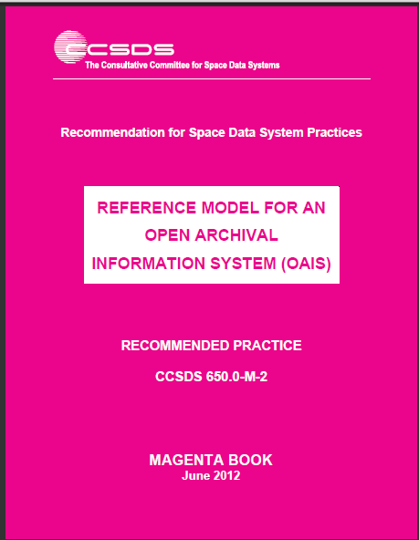

Slide 40
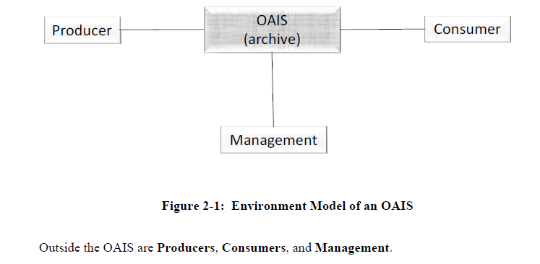
Simple OAIS Model

Slide 41
TRAC 2005-2007
OCLC & RLG. Trustworthy Repositories Audit & Certification: Criteria and Checklist. Version 1.0. February 2007. http://catalog.crl.edu/search~S1?/Xtrusted+repositories&searchscope=1&SORT=R/Xtrusted+repositories&searchscope=1&SORT=R&SUBKEY=trusted%20repositories/1,15,15,B/l856~b2212602&FF=Xtrusted+repositories&searchscope=1&SORT=R&6,6,,1,0.

Slide 42
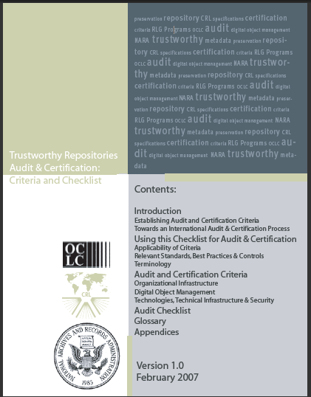

Slide 43
TRAC – 2005-2007
In 2003, RLG and the National Archives and Records Administration created a joint task force to address digital repository certification.
The goal of the RLG-NARA Task Force on Digital Repository Certification was to develop criteria to identify digital repositories capable of reliably storing, migrating, and providing access to digital collections.
Their challenge was to produce certification criteria and delineate a process for certification applicable to a range of digital repositories and archives, from academic institutional preservation repositories to large data archives and from national libraries to third-party digital archiving services.
2005-2007 additional work was done in Europe and there was a period of open comments on the draft.

Slide 44
CRL 10 Principles -2007
http://www.crl.edu/archiving-preservation/digital-archives/metrics-assessing-and-certifying/core-re
Organizations involved in devising the principles:
TRAC collaborators
The Digital Curation Center (U.K)
DigitalPreservationEurope
NESTOR (Germany)
Center for Research Libraries (North America)

Slide 45
Principles 1-4
The repository commits to continuing maintenance of digital objects for identified community/communities.
Demonstrates organizational fitness (including financial, staffing, and processes) to fulfill its commitment.
Acquires and maintains requisite contractual and legal rights and fulfills responsibilities.
Has an effective and efficient policy framework.

Slide 46
Principles 5-8
Acquires and ingests digital objects based upon stated criteria that correspond to its commitments and capabilities.
Maintains/ensures the integrity, authenticity and usability of digital objects it holds over time.
Creates and maintains requisite metadata about actions taken on digital objects during preservation as well as about the relevant production, access support, and usage process contexts before preservation.
Fulfills requisite dissemination requirements.

Slide 47
Principles 9-10
Has a strategic program for preservation planning and action.
Has technical infrastructure adequate to continuing maintenance and security of its digital objects.

Slide 48
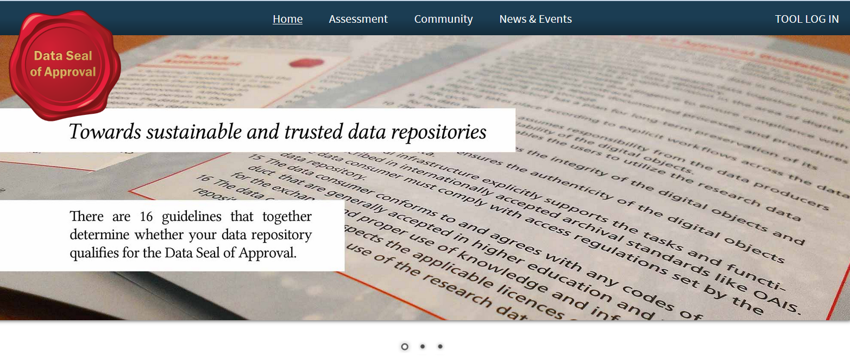

Slide 49
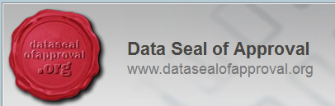
Data Seal of Approval - 2010
Creation of several organizations including:
Helmholtz Associates
CINES
Netherlands Organization for Scientific Research
DANS (Data Archiving and Networked Services)
ICPSR
KB Netherlands
Max Planck Institute
nestor
UK Data Archive

Slide 50
Guidelines Related to Data Producers
The data producer deposits the data in a data repository with sufficient information for others to assess the quality of the data and compliance with disciplinary and ethical norms.
The data producer provides the data in formats recommended by the data repository.
The data producer provides the data together with the metadata requested by the data repository.

Slide 51
Guidelines Related to Repositories
The data repository has an explicit mission in the area of digital archiving and promulgates it.
The data repository uses due diligence to ensure compliance with legal regulations and contracts including, when applicable, regulations governing the protection of human subjects.
The data repository applies documented processes and procedures for managing data storage.
The data repository has a plan for long-term preservation of its digital assets.
Archiving takes place according to explicit work flows across the data life cycle.

Slide 52
Guidelines Related to Repositories
The data repository assumes responsibility from the data producers for access and availability of the digital objects.
The data repository enables the users to discover and use the data and refer to them in a persistent way.
The data repository ensures the integrity of the digital objects and the metadata.
The data repository ensures the authenticity of the digital objects and the metadata.
The technical infrastructure explicitly supports the tasks and functions described in internationally accepted archival standards like OAIS.

Slide 53
Guidelines Related to Data Consumers
The data consumer complies with access regulations set by the data repository.
The data consumer conforms to and agrees with any codes of conduct that are generally accepted in the relevant sector for the exchange and proper use of knowledge and information.
The data consumer respects the applicable licenses of the data repository regarding the use of the data.

Slide 54
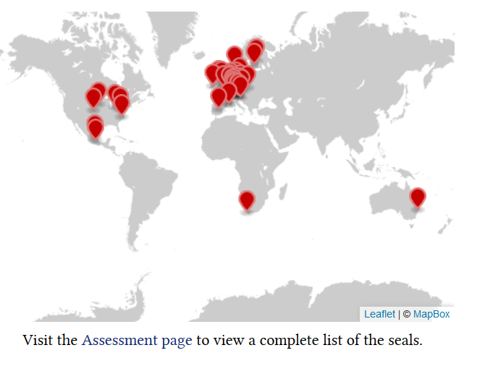
Seals Acquired Around the World

Slide 55
NESTOR - 2009
German competence network for digital preservation.
http://www.langzeitarchivierung.de/Subsites/nestor/EN/Home/home_node.html
nestor criteria - Catalogue of Criteria for Trusted Repositories Version II, 2009

Slide 56
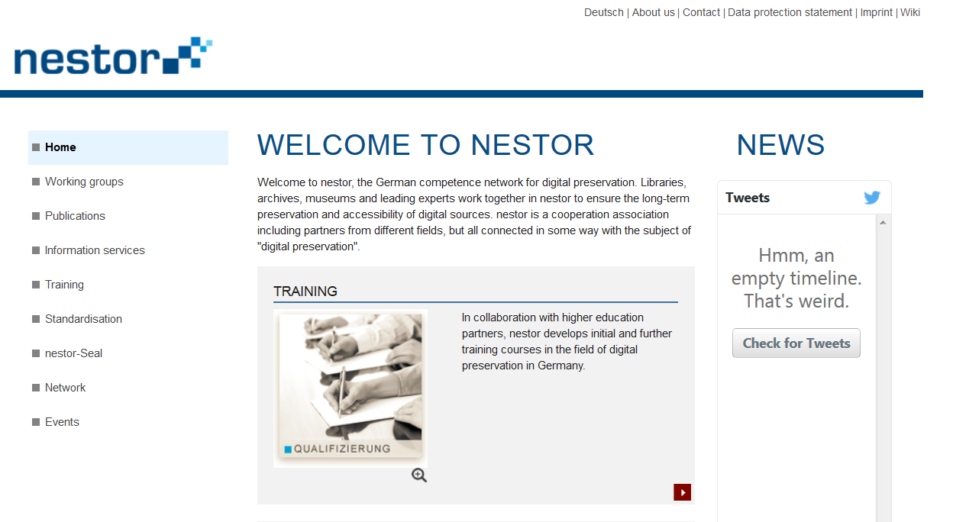

Slide 57
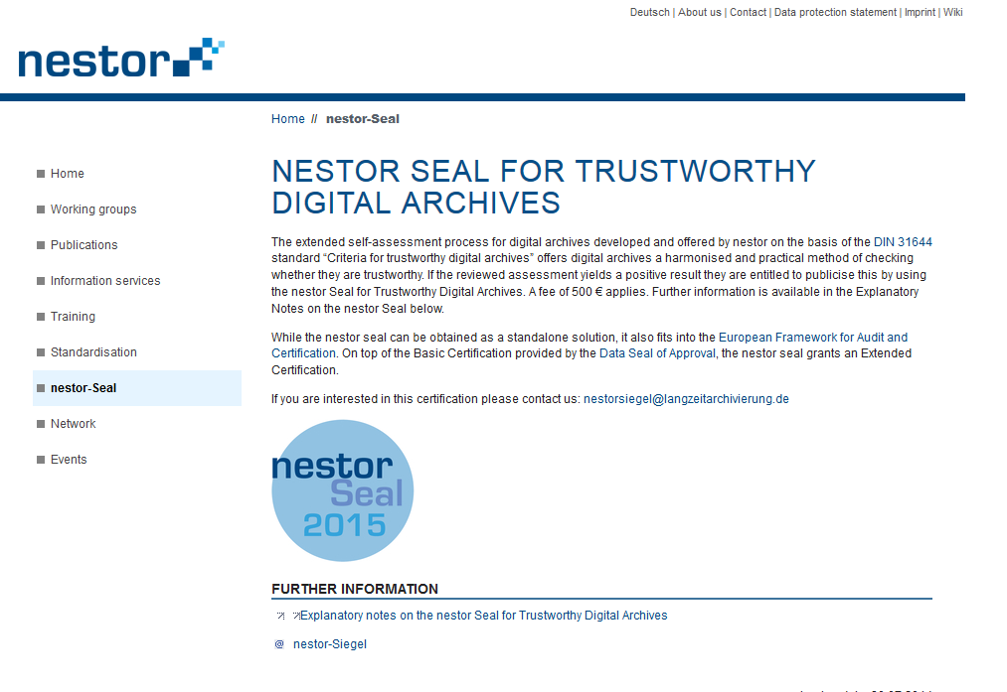

Slide 58
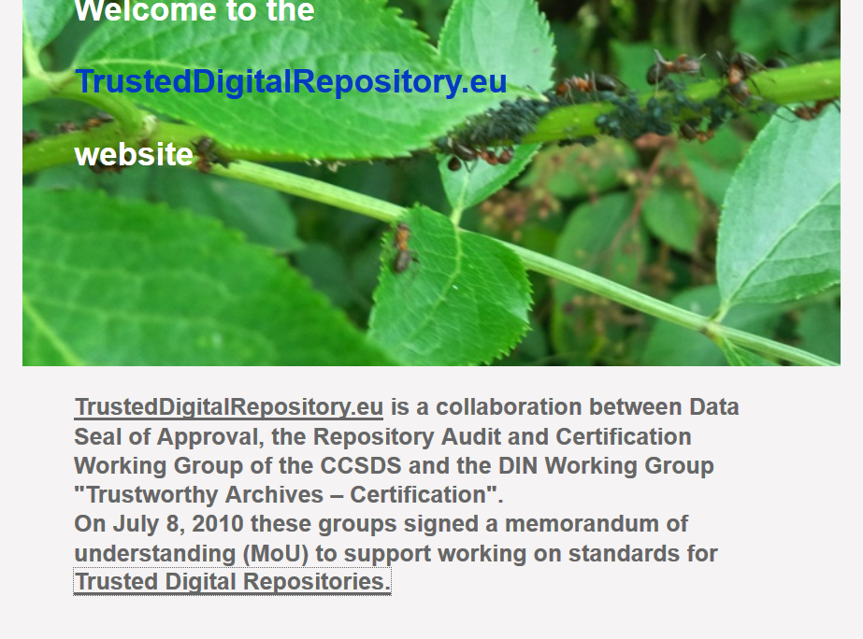

Slide 59
European Framework for Audit and Certification of Trustworthy Repositories
The framework will consist of a sequence of three levels, in increasing trustworthiness:
Basic Certification is granted to repositories which obtain DSA certification;
Extended Certification is granted to Basic Certification repositories which in addition perform a structured, externally reviewed and publicly available self-audit based on ISO 16363 or DIN 31644;
Formal Certification is granted to repositories which in addition to Basic Certification obtain full external audit and certification based on ISO 16363 or equivalent DIN 31644.

Slide 60
ISO 16363 & 16919
General requirements for conduct of all ISO/IEC Audits
Requirements For Bodies Providing Audit And Certification of Management Systems
(ISO/IEC 17021 )
Original Standard describing requirement of an ISO defined Open Archival Info System
Specific metrics that must be demonstrated to become a Certified ISO TDR
Specific additional requirements for conduct of ISO Audits of TDRs
Reference Model for an OAIS
(ISO 14721)
Audit and Certification of Trustworthy Digital Repositories
(ISO 16363 )
Requirements For Bodies Providing Audit And Certification of Trustworthy Digital Repositories
(ISO 16919 )
Certification
Notes:
There is a hierarchy of ISO standards concerned with good auditing.
ISO 16919 is positioned within this hierarchy in order to ensure that these good practices can be applied to the evaluation of the trustworthiness of digital repositories using ISO 16363.
It covers principles needed to inspire confidence that third party certification of the management of the digital repository has been performed with impartiality, competence, responsibility, openness, confidentiality, and responsiveness to complaints.
As you all probably know, the OAIS Reference Model (ISO 14721) is the pre-eminent, world-wide standard detailing the required functions for an Open Archival Information System (OAIS) Archives. It also provides a required information model for Archives. Although it is desirable to do so, Archives do not need to use the terminology in the information model and the standard. Repositories just need to be able to map their usage to the OAIS required items. Of course it most modern situations, it is easiest to just use the OAIS terminology to ease the communication process with most up-to-date and technically savvy archivists.
Many Archives have claimed to be OAIS compliant. ISO 16363 expands on OAIS standards and delivers specifically testable metrics that provide a more consistently verifiable situation for self-assessment and that
can lead to third-party certification.
ISO 16363 provides metrics concerning:
Organizational Infrastructure
e.g. The repository shall have a documented history of the changes to its operations, procedures, software, and hardware.
Digital Object Management
e.g. The repository shall have access to necessary tools and resources to provide authoritative Representation Information for all of the digital objects it contains.
Infrastructure and Security Risk Management
e.g.. The repository shall have procedures in place to evaluate when changes are needed to current software.
ISO/IEC 17021 is ISO’s and IEC’s generic auditing standard. Since the underlying organizational infrastructures and processes needed to audit almost any type systems is largely the same, it makes sense to provide a basic single, consistently applied process for all audits. Then specific requirements for specific applications can be layered on top of those generic requirements. We should also tell you that there is a whole suite of standards related to ISO/IEC 17021 that provide more detailed information. An example is ISO/IEC 17022 that provides details of what should be in a Audit Report.
ISO 16919 provides those specific requirements for auditing of candidate Trustworthy Digital Repositories according to the metrics defined in ISO 16363.
This module and the following modules will concentrate on the specific requirements defined in ISO 16919 while also including some discussion of the ISO/IEC 17021 items of relevance to auditors and repository staff. However the emphasis will be on ISO 16919 and how the competencies defined within it are related to the ISO 16363 metrics that the repository will be measured against.

Slide 61
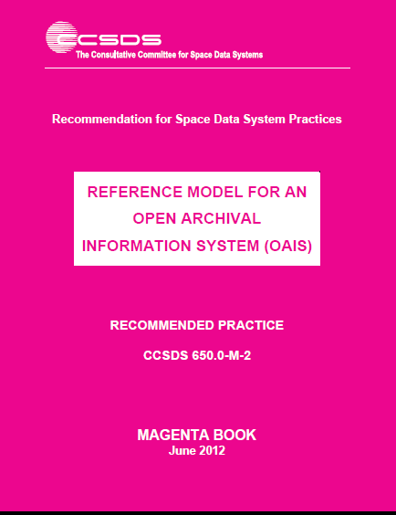
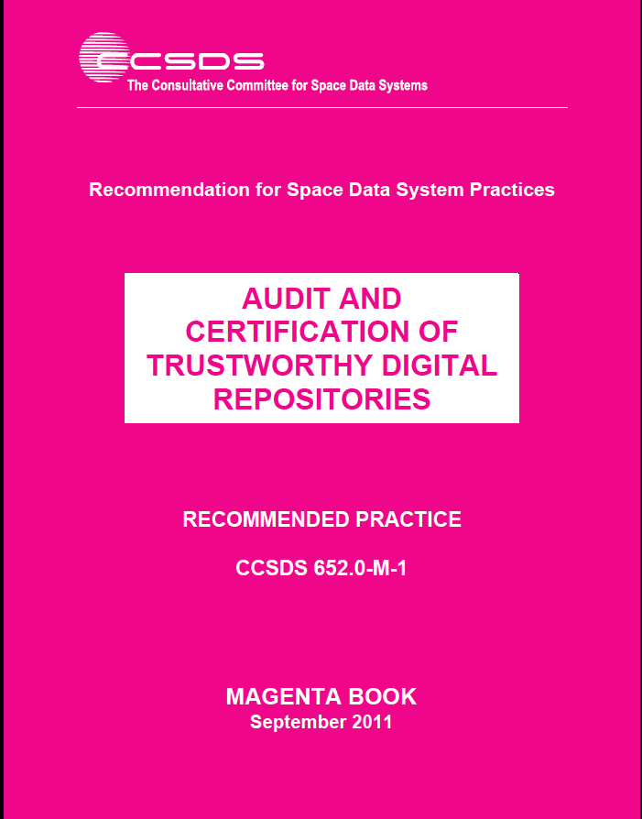
Get Your Standards
You can get all ISO Standards from ISO website at: http://www.iso.org/home/store/catalogue_tc/
You can also download the CCSDS Magenta Book equivalents of the ISO docs for free
ISO 14721 equivalent here: http://public.ccsds.org/publications/archive/650x0m2.pdf
ISO 16363 equivalent here: http://public.ccsds.org/publications/archive/652x0m1.pdf
ISO 16919 equivalent here: http://public.ccsds.org/publications/archive/652x1m2.pdf
Notes:
Note: Your National Body may also have a standards store usually priced in your local currency.
The ISO Standards actually have a few pages of ISO boilerplate that are attached to the front of the CCSDS documents

Slide 62
ISO 16363 - 2012
CCSDS. Audit and Certification of Trustworthy Digital Repositories. 2011. Magenta Book. http://public.ccsds.org/publications/archive/652x0m1.pdf
ISO 16363 http://www.iso.org/iso/iso_catalogue/catalogue_tc/catalogue_detail.htm?csnumber=56510
Blend of TRAC, nestor criteria, and DRAMBORA

Slide 63
Initial Audit - Overview
Application Process
Customer chooses Certification Body to conduct audit
Customer completes Certification Body’s Application
Certification Body evaluates application and decides whether or not to conduct audit
Certification Body plans for audit
Estimates time the audit will take
Adjusts for other certifications - verifiable, documented
Two phases
Stage 1
Stage 2
Final Audit Report
Certificate Awarded and Certification Registered

Slide 64
Repository Point of View: Application for the Audit
Applicant organisation must specify:
Details of the organization
What it does including legal obligations and legislative framework applicable e.g. national or international
How it does it – resources, outsourcing, etc.
Who does it, who helps, consults
Where it does it
Who it does it for – the Producers of the digital objects and the Designated Community
Scope of the audit
Which location(s), which part(s) of the organisation and/or which dataset(s) should be audited
Other audits
Does the organisation have any other certifications
Are additional certifications being sought during the same audit
Notes:
The basic information must of course be supplied, through the application process which the Certification Body provides e.g. web pages or paper forms.
Something which is likely to be very specific is the legal system in which the repository operates. Another special issue is what activities are outsourced – i.e. subcontracted and out of the repository’s direct control.
The scope of the audit is a critical decision for the repository. It may be a simple decision e.g. “include everything”, however it is likely that the repository contains digital objects which it does not guarantee to preserve e.g. temporary files, so that something more specific may be specified e.g. the digitally encoded information obtained by the MERIS satellite.
Something that might be relevant in terms of other certification is ISO 27000 – security. If the repository has this certification then the metrics (section 5 of ISO 16363) would not need as much checking.
------------------------- The following is from ISO 17021---------------------
ISO 17021 section 9.2.1
The certification body shall require an authorized representative of the applicant organization to provide the necessary information to enable it to establish the following:
the desired scope of the certification;
the general features of the applicant organization, including its name and the address(es) of its physical location(s), significant aspects of its process and operations, and any relevant legal obligations;
general information, relevant for the field of certification applied for, concerning the applicant organization, such as its activities, human and technical resources, functions and relationship in a larger corporation, if any;
information concerning all outsourced processes used by the organization that will affect conformity to requirements;
the standards or other requirements for which the applicant organization is seeking certification;
information concerning the use of consultancy relating to the management system.

Slide 65
ISO 16363
International Standard as of February 2012
From CCSDS (same folks who brought you OAIS)
Focus on what makes a repository trustworthy
Should be used with other ISO standards
Good as a guide for creating repositories as well as auditing them
Moderately high level.
OAIS is a reference model
TDRAC (ISO 16363) is a step below this
Still lacks metrics to go from general requirements assessments to detailed audit reports.

Slide 66
ISO 16363
Organizational Infrastructure
3.1 Governance and organizational viability
3.2 Organizational structure and staffing
3.3 Procedural accountability and preservation policy framework
3.4 Financial sustainability
3.5 Contracts, licenses, and liabilities

Slide 67
ISO 16363
Digital Object Management
4.1 Ingest: Acquisition of content
4.2 Ingest: Creation of the AIP
4.3 Preservation planning
4.4 AIP preservation
4.5 Information management
4.6 Access management
Infrastructure and Security Risk Management
5.1. Technical infrastructure risk management
5.2. Security risk management

Slide 68
What To Do?
Self-assessment
Preparing for an ISO audit
Commissioning an audit

Slide 69
Metrics 4.2.1-4.2.3
4.2 INGEST: CREATION OF THE AIP
4.2.1 THE REPOSITORY SHALL HAVE FOR EACH AIP OR CLASS OF AIPS PRESERVED BY THE REPOSITORY AN ASSOCIATED DEFINITION THAT IS ADEQUATE FOR PARSING THE AIP AND FIT FOR LONG-TERM PRESERVATION NEEDS.
4.2.1.1 The repository shall be able to identify which definition applies to which AIP.
4.2.1.2 The repository shall have a definition of each AIP that is adequate for long term preservation, enabling the identification and parsing of all the required components within that AIP.
4.2.2 THE REPOSITORY SHALL HAVE A DESCRIPTION OF HOW AIPS ARE CONSTRUCTED FROM SIPS.
4.2.3 THE REPOSITORY SHALL DOCUMENT THE FINAL DISPOSITION OF ALL SIPS
4.2.3.1 "The repository shall follow documented procedures if a SIP is not incorporated into an AIP or discarded and shall indicate why the SIP was not incorporated or discarded."
Notes:
Here are some more details of the Metric 4.2
You see there are 10 metrics with 21 sub-metrics.
Remember that the metrics and sub-metrics are designed to ensure that an auditor looks at certain things in detail.
These cover the CREATION of AIPs
The evidence can find more possibilities to be found by auditors (and to be created on the part of the repository):tem it should be identified and recorded in the repository record management system (specifically for the administrative information related to the service agreements, the contracts, etc.) and could/should be collected in manuals approved and adopted by the repository: a general framework should be defined and specific procedures (for each class of AIP) should be developed.

Slide 70
Metrics 4.2.4-4.2.5
4.2.4 THE REPOSITORY SHALL HAVE AND USE A CONVENTION THAT GENERATES PERSISTENT, UNIQUE IDENTIFIERS FOR ALL AIPS
4.2.4.1 The repository shall uniquely identify each AIP within the repository.
4.2.4.1.1 The repository shall have unique identifiers.
4.2.4.1.2 The repository shall assign and maintain persistent identifiers of the AIP and its components so as to be unique within the context of the repository.
4.2.4.1.3 Documentation shall describe any processes used for changes to such identifiers.
4.2.4.1.4 The repository shall be able to provide a complete list of all such identifiers and do spot checks for duplications.
4.2.4.1.5 The system of identifiers shall be adequate to fit the repository’s current and foreseeable future requirements such as numbers of objects.
4.2.4.2 The repository shall have a system of reliable linking/resolution services in order to find the uniquely identified object, regardless of its physical location.
4.2.5 THE REPOSITORY SHALL HAVE ACCESS TO NECESSARY TOOLS AND RESOURCES TO PROVIDE AUTHORITATIVE REPRESENTATION INFORMATION FOR ALL OF THE DIGITAL OBJECTS IT CONTAINS.
4.2.5.1 The repository shall have tools or methods to identify the file type of all submitted Data Objects.
4.2.5.2 The repository shall have tools or methods to determine what Representation Information is necessary to make each Data Object understandable to the Designated Community.
4.2.5.3 The repository shall have access to the requisite Representation Information.
4.2.5.4 The repository shall have tools or methods to ensure that the requisite Representation Information is persistently associated with the relevant Data Objects.

Slide 71
Metrics 4.2.6-4.2.7
4.2 INGEST: CREATION OF THE AIP
4.2.6 THE REPOSITORY SHALL HAVE DOCUMENTED PROCESSES FOR ACQUIRING PRESERVATION DESCRIPTION INFORMATION (PDI) FOR ITS ASSOCIATED CONTENT INFORMATION AND ACQUIRE PDI IN ACCORDANCE WITH THE DOCUMENTED PROCESSES.
4.2.6.1 The repository shall have documented processes for acquiring PDI.
4.2.6.2 The repository shall execute its documented processes for acquiring PDI.
4.2.6.3 The repository shall ensure that the PDI is persistently associated with the relevant Content Information.
4.2.7 THE REPOSITORY SHALL ENSURE THAT THE CONTENT INFORMATION OF THE AIPS IS UNDERSTANDABLE FOR THEIR DESIGNATED COMMUNITY AT THE TIME OF CREATION OF THE AIP.
4.2.7.1 Repository shall have a documented process for testing understandability for their Designated Communities of the Content Information of the AIPs at their creation.
4.2.7.2 The repository shall execute the testing process for each class of Content Information of the AIPs.
4.2.7.3 The repository shall bring the Content Information of the AIP up to the required level of understandability if it fails the understandability testing.

Slide 72
Metrics 4.2.8-4.2.10
4.2.8 THE REPOSITORY SHALL VERIFY EACH AIP FOR COMPLETENESS AND CORRECTNESS AT THE POINT IT IS CREATED.
4.2.9 THE REPOSITORY SHALL PROVIDE AN INDEPENDENT MECHANISM FOR VERIFYING THE INTEGRITY OF THE REPOSITORY COLLECTION/CONTENT.
4.2.10 THE REPOSITORY SHALL HAVE CONTEMPORANEOUS RECORDS OF ACTIONS AND ADMINISTRATION PROCESSES THAT ARE RELEVANT TO AIP CREATION.

Slide 73
described
by
delimited
by
Archival Information Package
Package Description
Packaging Information
derived
from
identifies
Content Information
Preservation Description
Information
further described by
Interpreted using
*
Data
Object
Representation
Information
Interpreted using
1
Physical Object
Digital Object
Structure Information
Semantic Information
Other Representation Information
Reference Information
Context Information
Access Rights Information
1
adds meaning to
Provenance Information
Fixity Information
1...*
Bit
Notes:
Figure 4-18: Archival Information Package (Detailed View)

Slide 74
Metrics 4.2 context
Maintain RepInfo and PDI
4.2 INGEST: CREATION OF THE AIP
Producer
Create AIP with adequate RepInfo and PDI
Submission Information Package
Archival
Information Package
Consumer
Discard all or part of SIPs
DIP
Get information from the AIP
Notes:
We can think of this as a process.
A diagram which gives the general idea is shown here
SIPs come in
Some are discarded – the archive has an active role – not passive
Others are used to create AIPs
These AIPs must be preserved
They are also used to provide what the Consumer (Designated Community) needs
4.2.3 The repository shall document the final disposition of all SIPs.
In particular the following aspect must be checked.
4.2.3.1 The repository shall follow documented procedures if a SIP is not incorporated into an AIP or discarded and shall indicate why the SIP was not incorporated or discarded.
Supporting Text
This is necessary in order to ensure that the SIPs received have been dealt with appropriately, and in particular have not been accidentally lost.
First a reminder of the AIP definition

Slide 75
Metrics overview
ISO 16363: Metric 4.2
Must know what happened to each SIP
Must know how AIP is constructed from SIPs
Must know the structure and construction of all AIPs
Must have RepInfo
Must have PDI
Must ensure collection of AIP is complete
Must ensure integrity of the collections in the repository (i.e., no AIPs have gone missing)
Must be able to locate AIPs
Must ensure AIP contents is understandable to Designated Community
Must have contemporaneous records
Notes:
Breaking it down in a little more detail we have the following
[GO THROUGH THE BULLETS]
The repository must understand the “motivation” for each component of an AIP
We can see this in the metrics - I’ve changed the order to align with the process flow I just outlined.

Slide 76
Self-Assessment
DRAMBORA and ISO 16363 are complementary tools you can use to conduct a self-assessment.
Pick one or, better, both.
This will take a good deal of time but you will have a stronger repository when you are done.
You will know your repository in a very intimate way;
You will be able to spot weaknesses;
You will fix many of these along the way, especially by developing missing or weak policies (and before others know);
You will have data/facts to make a case to your resource allocators that you need more dollars/workers/hardware, etc.
No doubt in my mind that the time spent in self-assessment using these tools is worth every penny and minute.

Slide 77
Peer Assessment
Internal Audit Tool
Designed by Nancy McGovern
Hosted at Archivematica
Helpful for both self- and peer-audits
Responsibilities
Requirements
Status

Slide 78
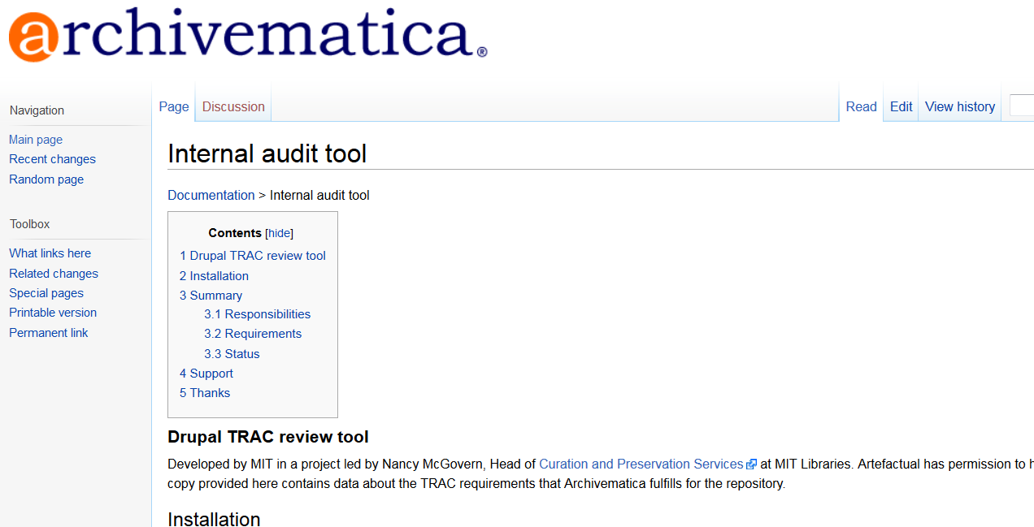

Slide 79
Preparing for an ISO 16363 Audit
Read the standard and all the other guidelines
Know thy repository
Conduct a self-assessment
Find auditors…..

Slide 80
ANAB to Develop ISO 16363 Accrediting Program
ANSI-ASQ National Accreditation Board
http://anab.org/media/53684/hu319.pdf

Slide 81
Exercise 3: ISO 16363
Break into small groups and discuss how your unit/organization could use ISO 16363 to improve your repositories and data management.

